Slide 1
CUSTOMER CHURN CLASSIFICATION
Project Title
Predict customer churn by using Python (Machine Learning)
SR No | NAME
1 | Naveenkumar Koli
2 | Vallabhapurapu Jahnavi
3 | SoumyabrataBanerjee
4 | Avanthi Sangani
5 | Abhishek Yadavalli
6 | Suneesha

Slide 2
BUSINESS OBJECTIVE
Customer attrition, also known as customer churn, customer turnover, or customer defection, is the loss of clients or customers.
Customer churn is a big problem for telecommunications companies. Indeed, their annual churn rates are usually higher than 10%.
The challenge is to design a model that will be able to predict whether a customer will stay or leave the company

Slide 3
Project Flow
Read the csv file
Perform Preprocessing Steps
Train Test Split
Feature Extraction
Model Building
Model Evaluation
Deployment
Classification

Slide 4
Dataset description
The data set includes the following variables:
account length
voice_mail_plan
voice_mail_messages
day_mins
evening_mins
night_mins
international_mins
customer_service_calls
international_plan
day_calls
day_charge
evening_calls
evening_charge
night_calls
night_charge
international_calls
international_charge
total_charge
churn: This is the target variable. It is the one that determines whether the client is still in the company or not. (1-Churn, 0-No Churn)

Slide 5
Preprocessing/EDA Steps
Describe dataset: Number of rows/columns, missing data, data types, preview.
Clean data: Handle missing data, invalid data types, incorrect values and outliers
Visualize data distributions: Bar charts, histograms, box plots.
Calculate and visualize: Correlations (relationships) between variables, Heat map
Perform feature selection for columns if any
Scale the data before proceeding to model building
Balancing the data
Split data to train and test

Slide 6
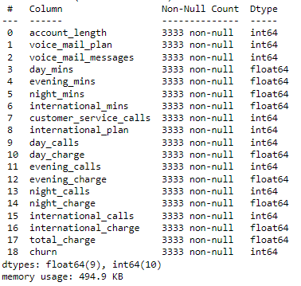
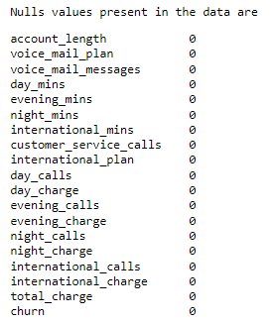
Describe dataset: Number of rows/columns, missing data, data types, preview

Slide 7
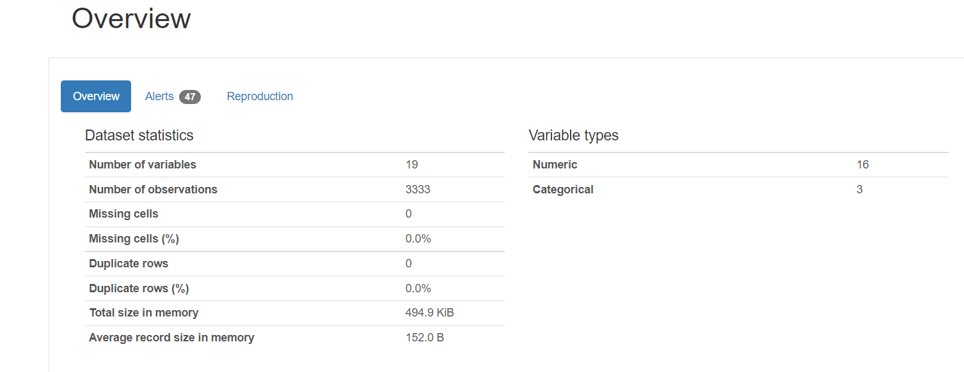

Slide 8
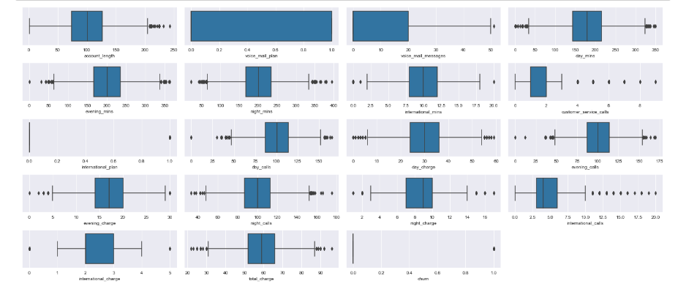
Box plot representation to detect the outliers if any

Slide 9
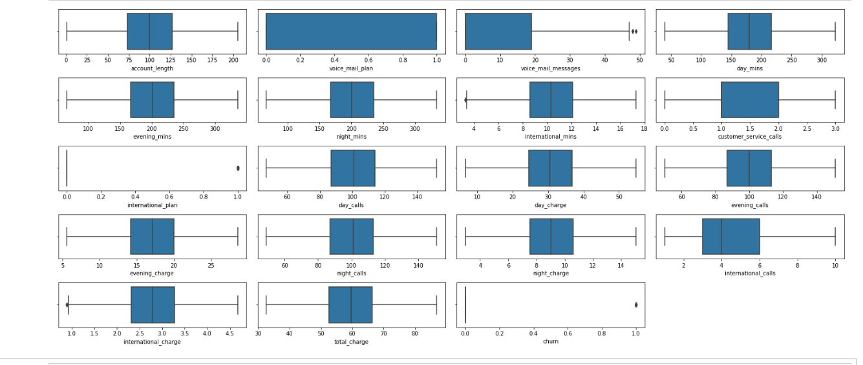
Cleaning the outliers

Slide 10


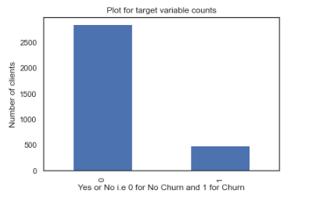
Visualize data distributions
Distribution of data w.r.t target variable
Counts wise distribution
Percentage wise distribution
This shows data is biased towards
0th class. So going forward we need
To balance the data

Slide 11
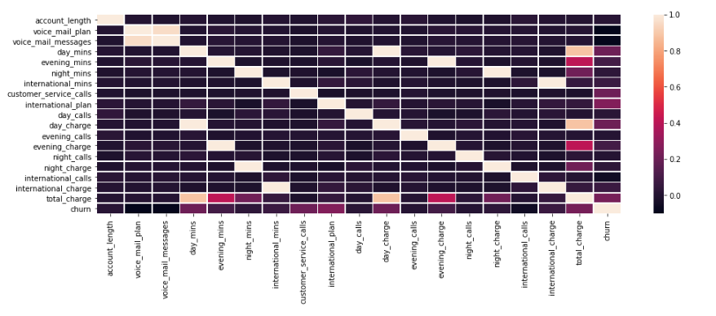
Correlation heat map

Slide 12
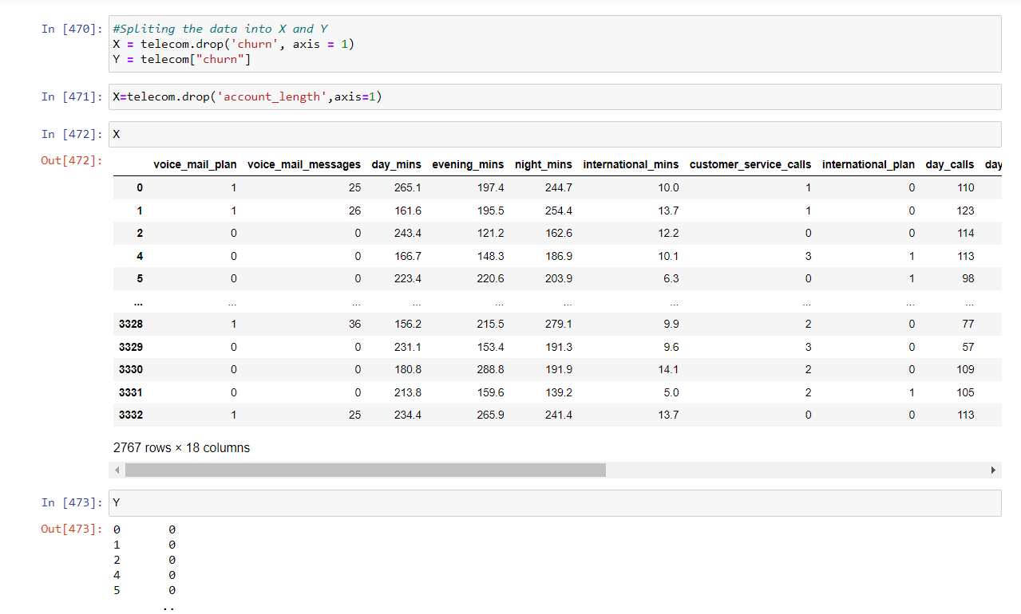
Splitting the data set

Slide 13
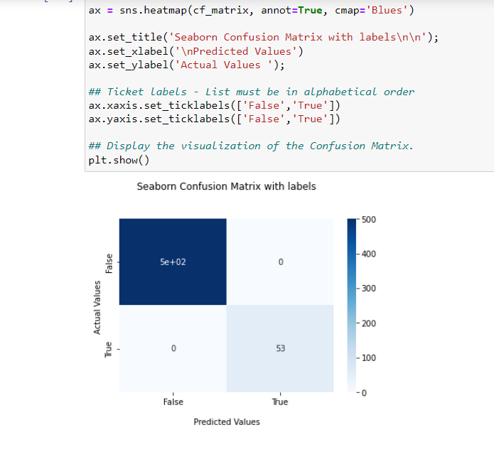
Confusion matrices after training the dataset

Slide 14
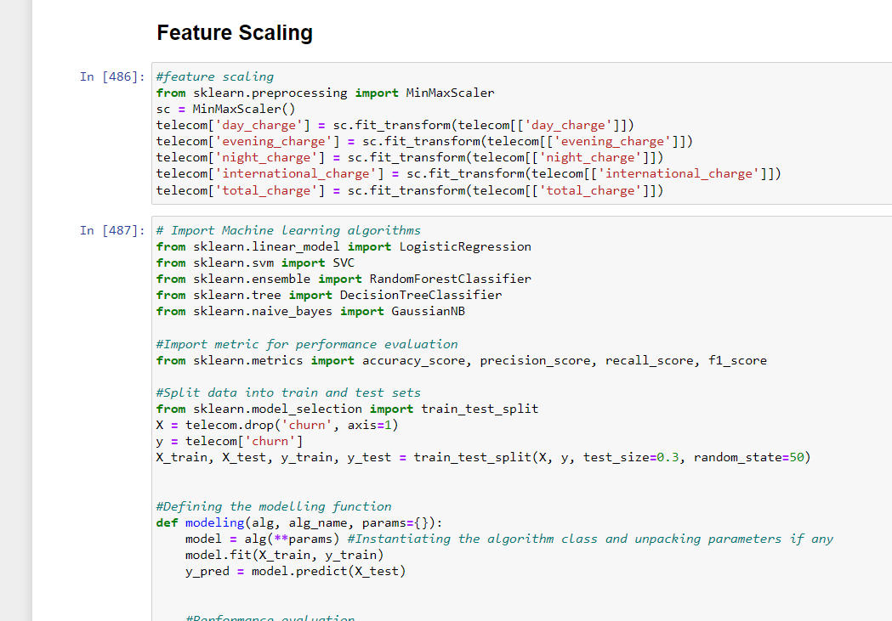
Feature scaling

Slide 15
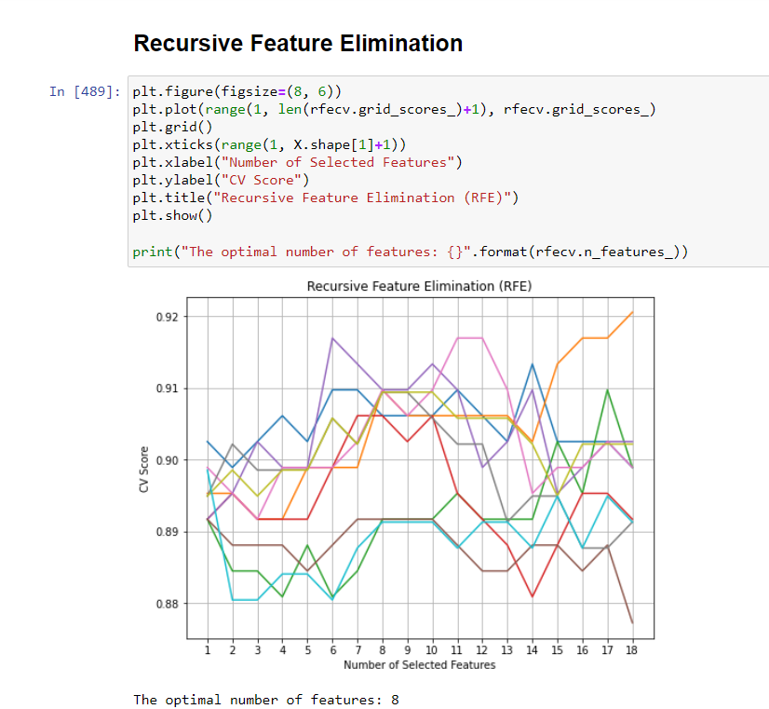
Recursive Feature Elimination

Slide 16
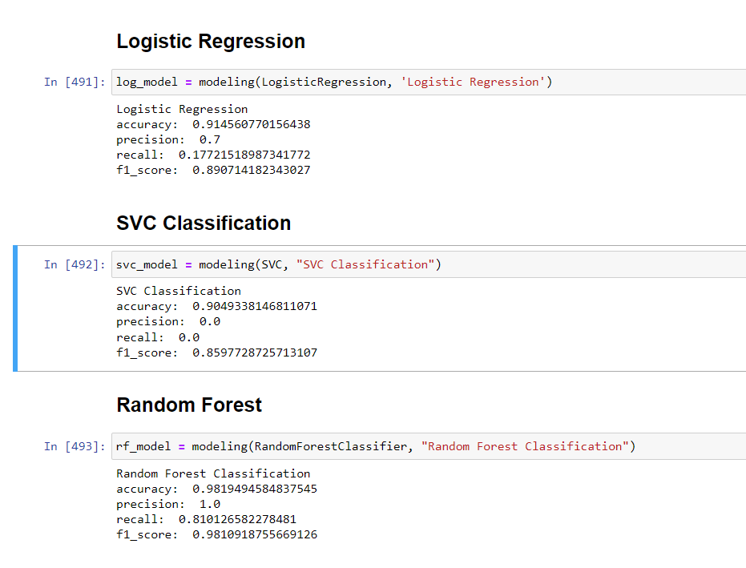
Modeling

Slide 17
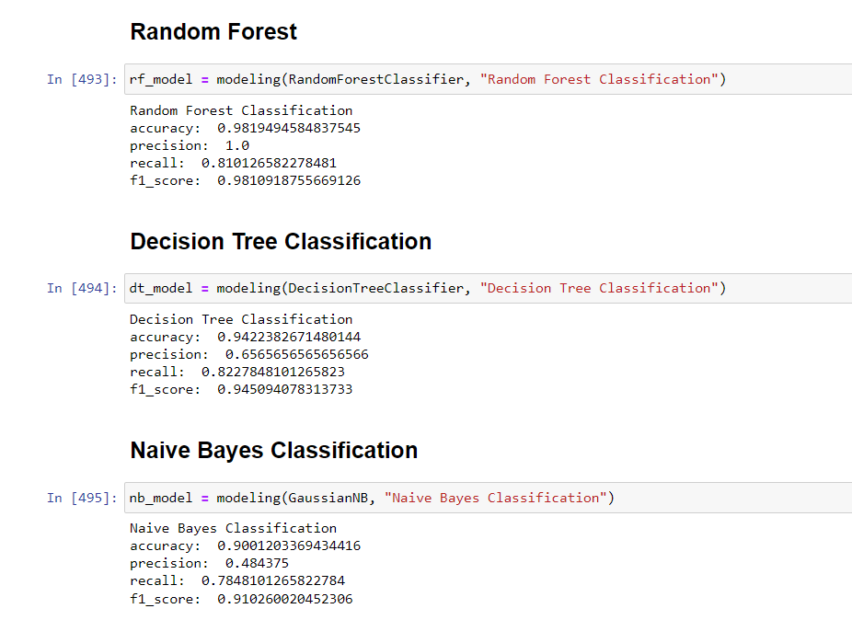

Slide 18
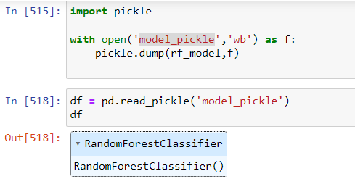
So finally after reviewing all the models we went with the Random forest classifier and build a pickle file to do the deployenmnet

Slide 19
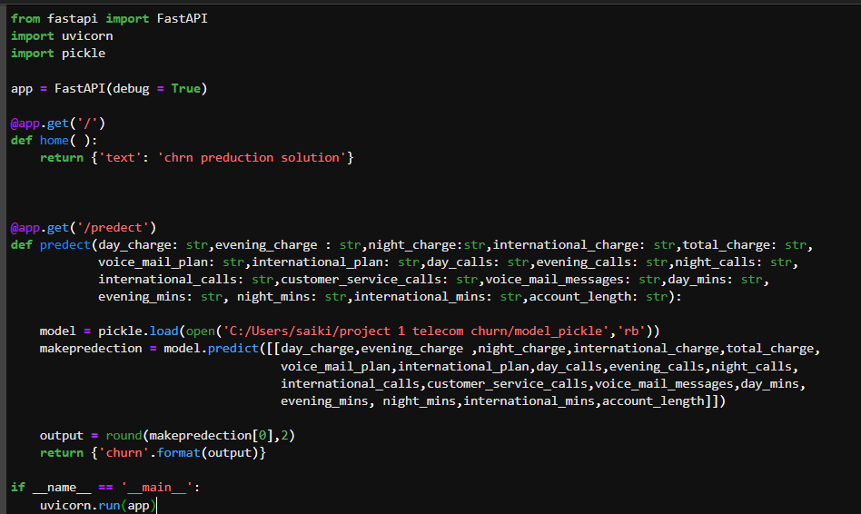
We used fast API to deploy our modeling

Slide 20
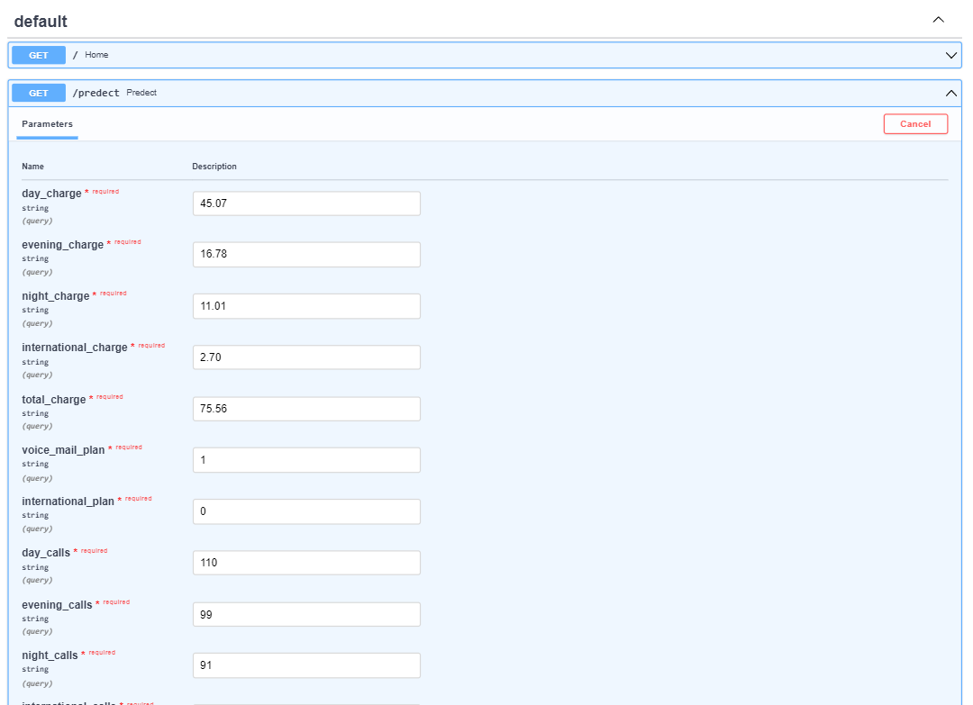
Giving input values to predict the data set

Slide 21
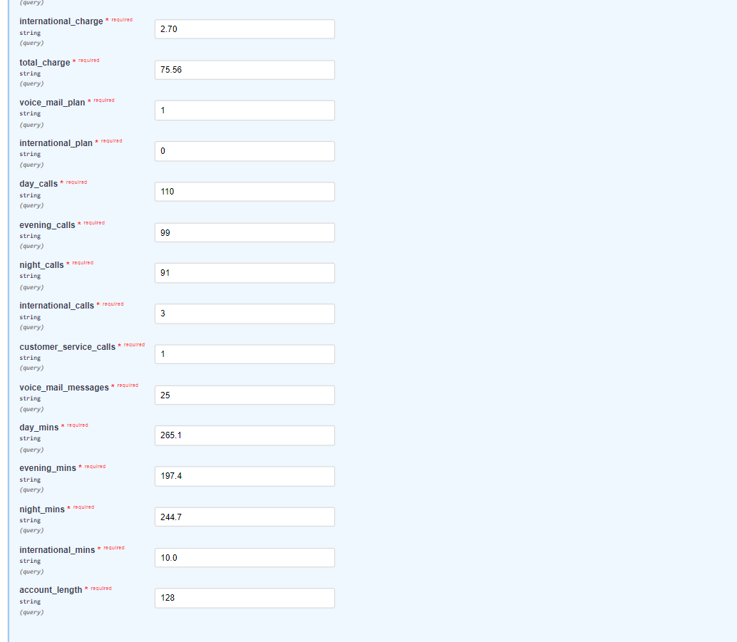

Slide 22
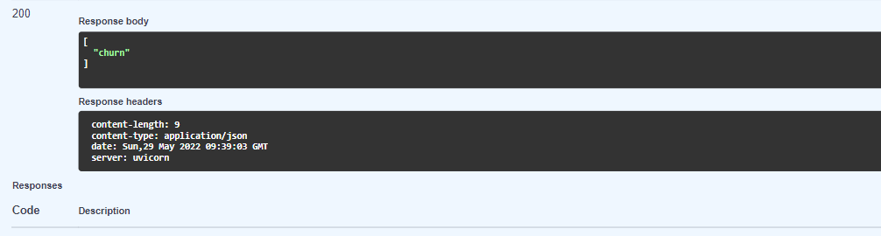
The response we got as “churn”

